Slide 1
LEARNING TO REFINE OBJECT SEGMENTS
Digital Image Processing Course
Author: Pedro O. Pinheiro , Tsung-Yi Lin , Ronan Collobert, Piotr Doll´ar
FACEBOOK AI RESEARCH (FAIR)
Presenting: ELAD SOFER
09.7.2023
Notes:
במאמר זה הראו שיטה לבצע דיבלורריינג בעזרת למידה עמוקה. הם החליפו את חלק מהבלוקים של קונבולוציה בבלוקים יחודיים שמותאמים לבעיה זו והראו תוצאות מאוד טובות.

Slide 2
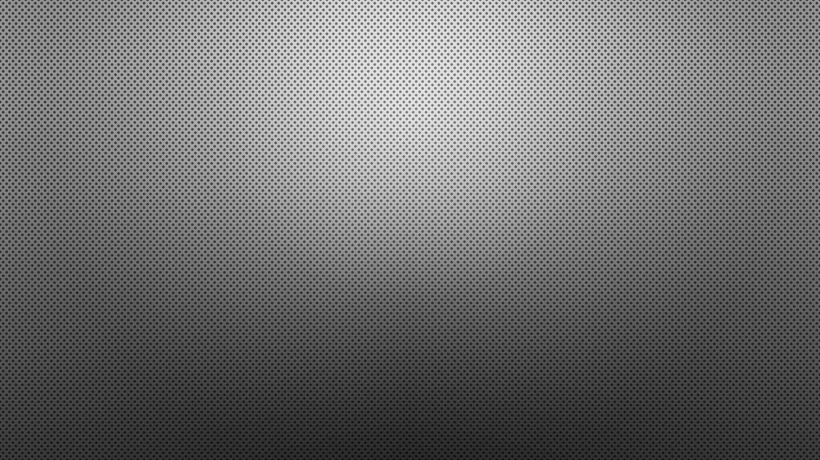
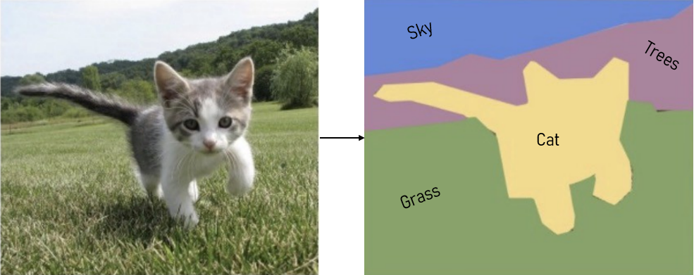
What is segmentation?
Segmentation is the process of dividing an image into multiple segments or regions
The goal is to both detect and segment each individual object in the pixel-level
Notes:
טשטוש תנועה הוא תופעה של מריחה שנוצרת כתוצאה מתנועה של אובייקטים מול המצלמה. התופעה קורית כאשר יש הבדל מהירויות בין המצלמה לבין האובייקטים.

Slide 3
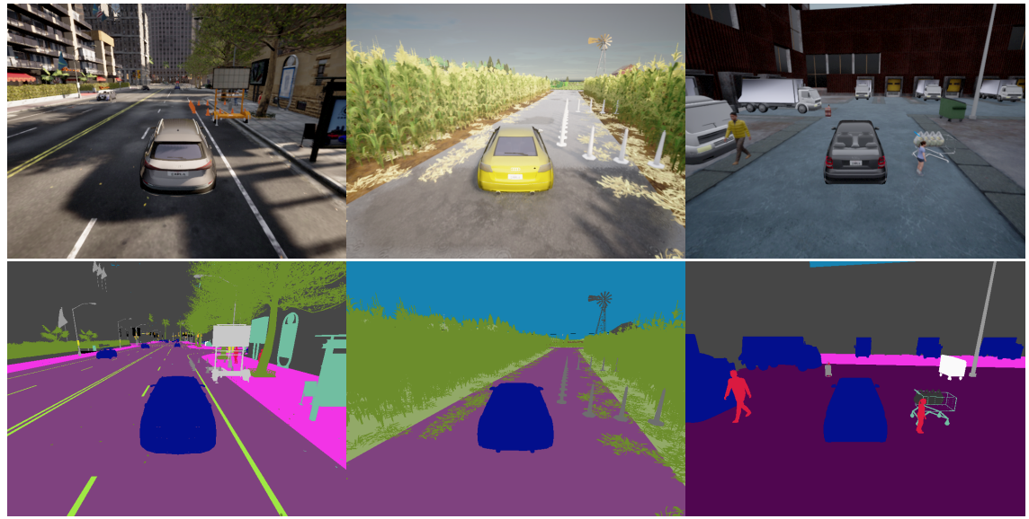
class-agnostic segmentation
partition an image into different regions based on their visual properties.
without identifying or categorizing the objects present in the image.

Slide 4
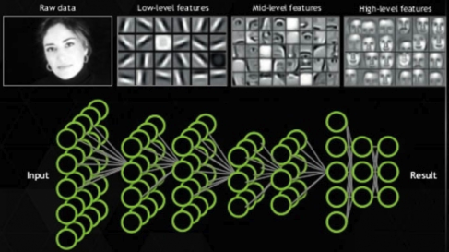
Feature-level IN CNN
Low- features - lower layers capture rich spatial information about the image, such as edges, corners, and textures.
High-features - As the network gets deeper, the layers become more specialized and start to encode higher-level features, such as object parts and shapes.
Why the deeper the network gets the features it encode is higher?
Notes:
מעבר

Slide 5
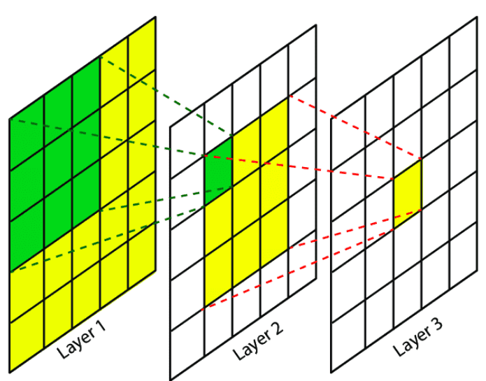
Prerequisite- Receptive field
Receptive field refers to the region of the input data that a particular neuron or feature in the network "sees" or is influenced by.
Notes:
הRF הוא מדד של כמות הפיקסלים בכניסה שמשפיע על מוצא אחד.

Slide 6
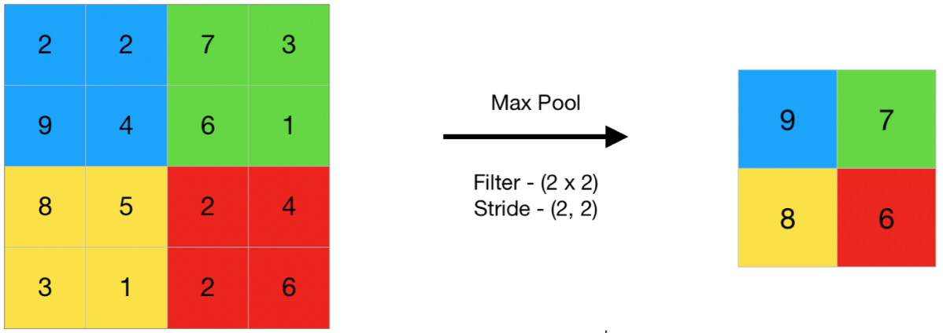
Prerequisite- pooling
Pooling is a down-sampling operation that reduces the spatial dimensions
Artificially increases receptive field size which make it effective in high-level feature extraction
Looses information due to down-sampling.
Notes:
הנוירון שקיבל את הספרה 9, ״ראה״ את כלל המתמודדים שהתחרו על המקסימום.

Slide 7
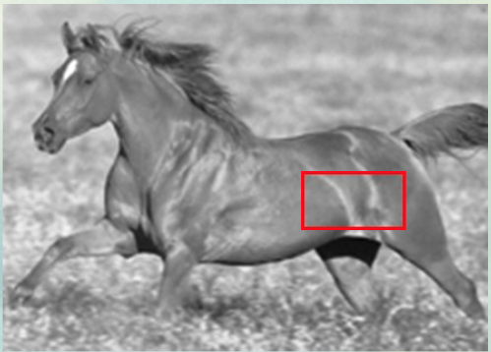
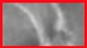
where is the object boundary?
Notes:
בהינתן התמונה, האם ניתן להגיד איפה הגבול של האובייקט?
ניתן לראות שבהינתן חלק עם Receptive field נמוך הרגישות שלנו לגבולות איננה נכונה וכך גם של הרשת.

Slide 8

Which features are best to use for the final image segmentation? From the lower or upper layers?
Notes:
האם כדאי להסתכל ברמת המאקרו או ברמת המיקרו?

Slide 9
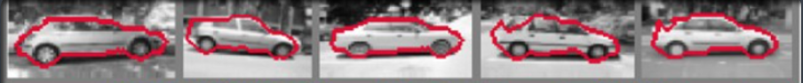
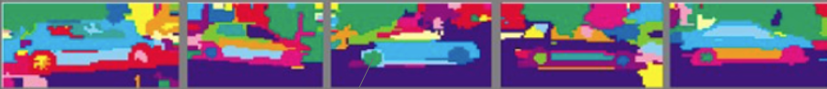
Top down approach vs bottom-up approach
Top-down approaches, start with high-level features, such as object shape and context, and use them to guide the segmentation process.
Coarse segmentation (Top-Down)
Bottom-up approaches start with low-level features, such as edges, corners, and textures, and use them to generate object proposals. These proposals are then refined using higher-level features.
The wheel is recognized as different object (Bottom-Up)

Slide 10
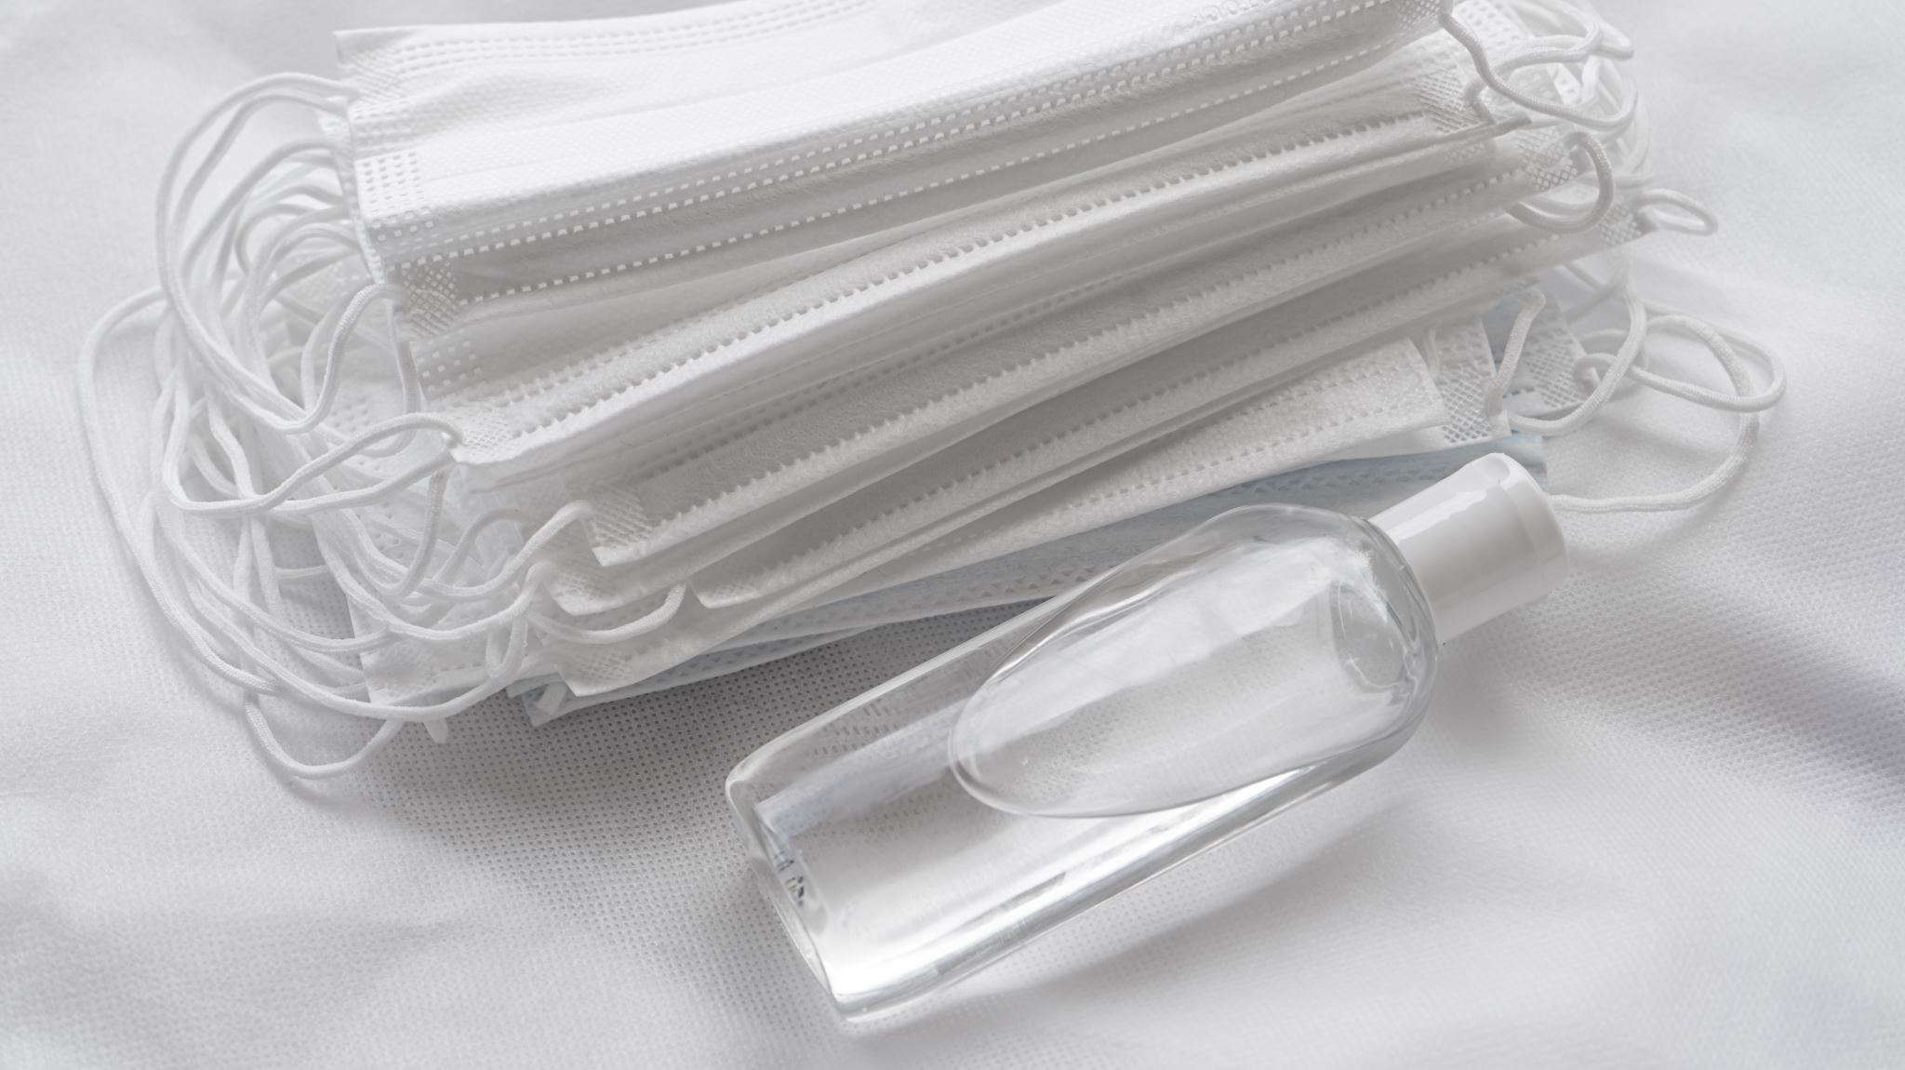
Could we combine both?

Slide 11
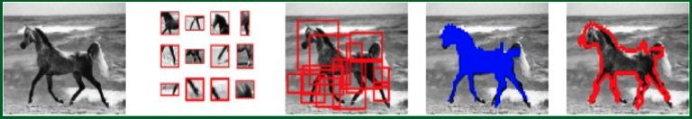
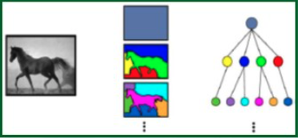
Sharp-mask - Combining top-down and buttom-up
Notes:
This difference between different threshold for object-scores

Slide 12
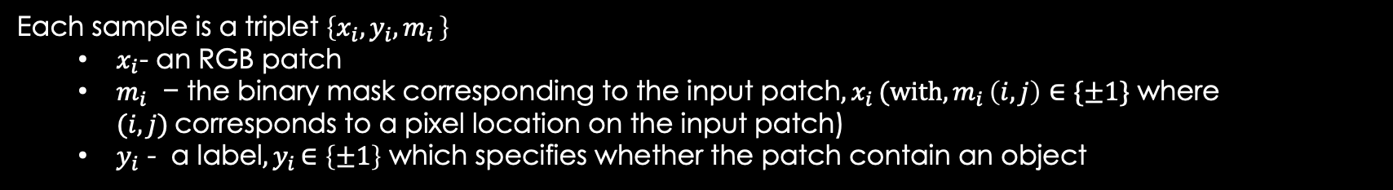
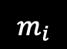
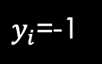
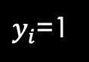
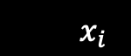
How the data looks like?
The dataset contains RGB patches $X= \left\{x_{1}, x_{2}, …, x_{n}\right\}$
Each sample is a triplet $\left\{x_{i}, y_{i}{,m}_{i}\right\}$
$x_{i}$- an RGB patch
$m_{i}\text{ − }\text{the} \text{binary} \text{mask} \text{corresponding} \text{to} \text{the} \text{input} \text{patch}{,x}_{i}\text{(}\text{with}{,m}_{i}\left(i,j\right)∈\{±1\} \text{where} (i,j) \text{corresponds} \text{to} \text{a} \text{pixel} \text{location} \text{on} \text{the} \text{input} \text{patch}\text{)}$
$y_{i}$ - a label${,y}_{i}∈\left\{±1\right\}$ which specifies whether the patch contain an object
A patch $x_{i}$is given label $y_{i}=1$if it satisfies:
The patch contain an object roughly centered in the input patch
The object is fully contained in the patch
$y_{i}$=1
$y_{i}$=-1
$$x_{i}$$
$$m_{i}$$

Slide 13

To fully understand sharp-mask… we need to understand its base model – deep mask

Slide 14
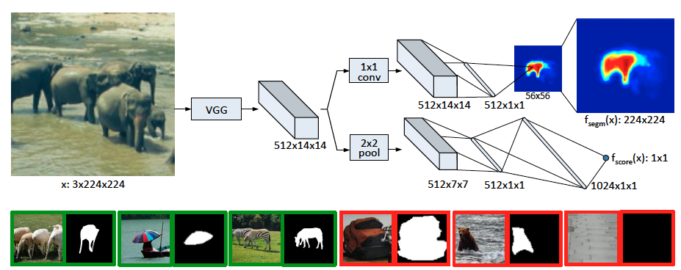
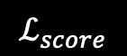
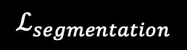
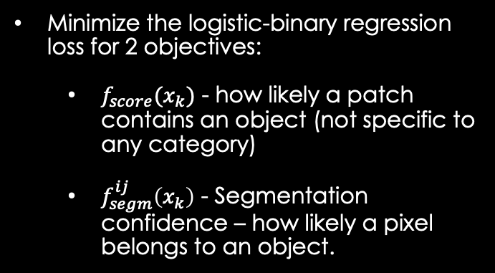
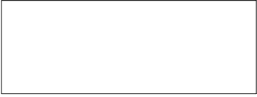
DEEP mask (top-down approach) - base model for sharp-mask
fully connected to each pixel classifier to generate an output of dimension 56 × 56 mask
bilinear up-sampling
(interpolation)
Fully connected which represents
Segmentation high level feature vector
We will refer this vector as $V_{f}$
TRAINING
only “one object” mask
Class-agnostic segmentation
Minimize the logistic-binary regression loss for 2 objectives:
$f_{score}(x_{k})$ - how likely a patch contains an object (not specific to any category)
$f_{segm}^{ij}\left(x_{k}\right)$ - Segmentation confidence – how likely a pixel belongs to an object.
2 × 2 max pooling
two fully connected layers
Non-linear ReLU.
dropout with 0.5 rate.
A final linear layer which generates a 512x1x1 object score
Loss is minimizing only positive samples.
$$ℒ_{segmentation}$$
$$ℒ_{score}$$
Notes:
Reduced capacity since both objectives are being trained together

Slide 15
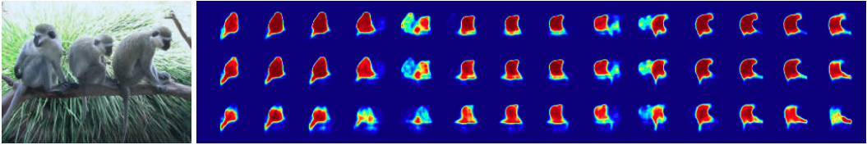
INFERENCE
Each image is divided into multiple patches in a way that at least one patch contains an object.
The model predicts a mask and a score for each patch
how do we pick the winning mask, $m_{w}$ for each object?

Slide 16
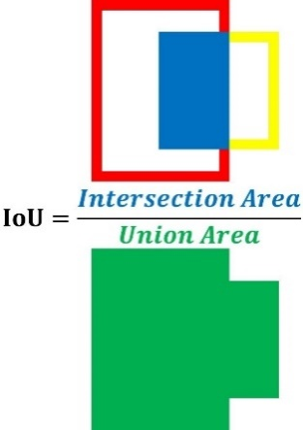
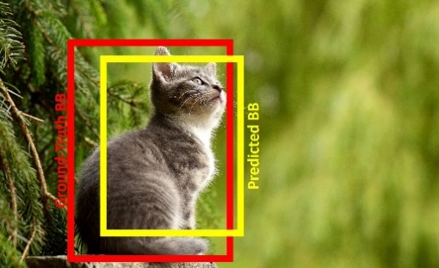
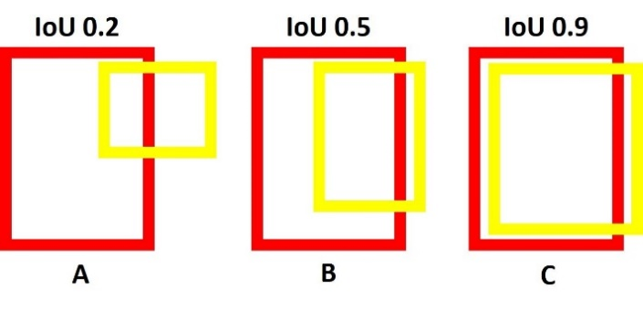
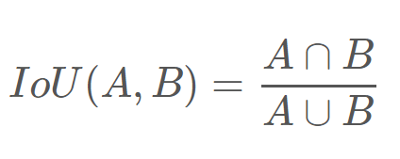
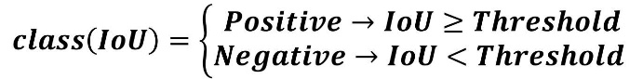
Intersection over union (iou)
IoU measures the overlap between 2 regions , A and B.

Slide 17
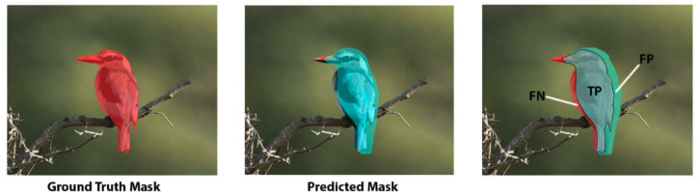
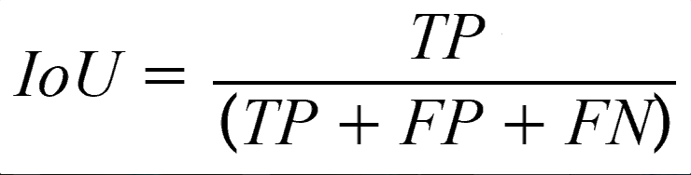
Intersection over union (iou)
IoU measures the overlap between 2 regions , A and B.
A= Ground-truth mask, B=Predicted Mask,

Slide 18
Non-max-suppression – picking the winning mask
Delete all the masks which have a score lower than 0.5
2. From the left masks:
a) take the highest score mask as chosen prediction $m_{w}$
b) delete all the masks, $m_{j}$ which has $IoU(m_{w},m_{j})>0.5$ (since they describe the same object)
3. return to 2 and repeat until one mask left per object.
4. If several masks (of different objects are left), pick the highest score mask.

Slide 19
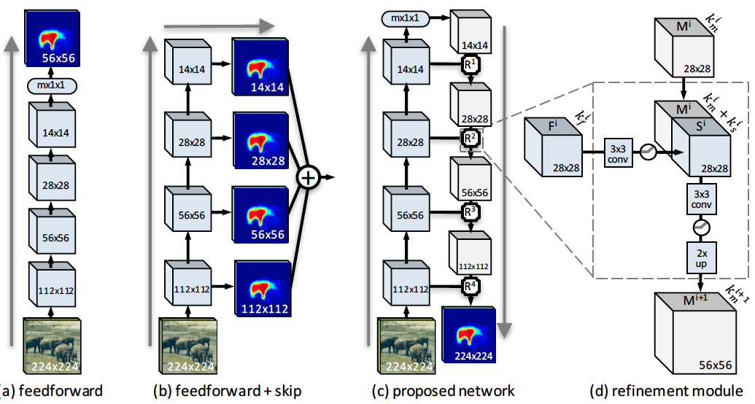
related work & sharp-mask architecture
(a) Feedforward nets, such as DeepMask, predict masks using only upper-layer CNN features, resulting in coarse pixel masks. (bottom-up)
(b) Common `skip' architectures are equivalent to making independent predictions from each layer and averaging the results.
C) sharp-mask architecture - using deep-mask as forward path, and adding refinement module. (Bottom-Up)
Notes:
What is the mx1x1 vector?

Slide 20
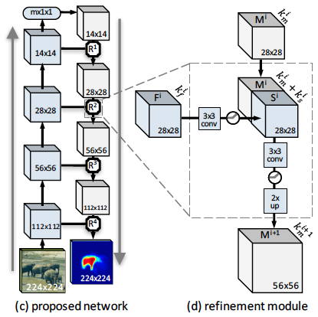
MOTIVATION
Our goal is to merge the spatially rich information from low-level features with the high-level semantic information encoded in upper network layers.
3 guiding principles:
Object-level information is often necessary to segment an object.
Given object-level information, segmentation should proceed in a top-down fashion, successively integrating information from earlier layers.
The approach should invert the loss of resolution from pooling via refinement module.

Slide 21
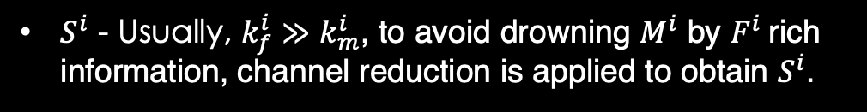
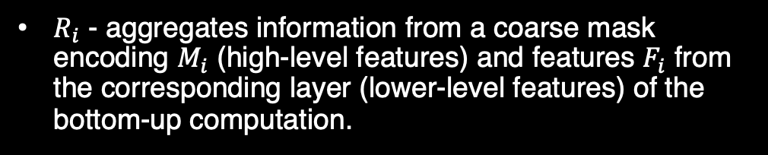
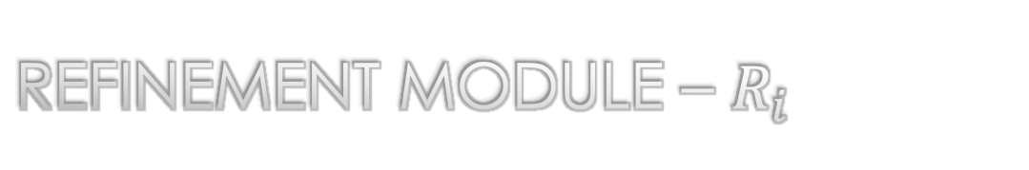
Refinement module – $R_{i}$
$M^{i}$ – Previous mask information (bottom-up)
$F^{i}$– Current feature-map
$R_{i}$ - aggregates information from a coarse mask encoding $M_{i}$ (high-level features) and features $F_{i}$ from the corresponding layer (lower-level features) of the bottom-up computation.
Formulation - $R^{i}\left(M^{i},F^{i}\right)=M^{i+1}$
Designed to invert the information loss from the pooling layers and incorporate lower-level features via bottom-up
$S^{i}$ - Usually, $k_{f}^{i}≫k_{m}^{i}$, to avoid drowning $M^{i}$ by $F^{i}$rich information, channel reduction is applied to obtain $S^{i}$.
2x up - bilinear interpolation (also in the final layer to obtain ground-truth mask dimensions)
Notes:
Up – bilinear interpolation
HOW DOES THIS ARCHITECTURE ALIGNED WITH DEEP MASK?

Slide 22
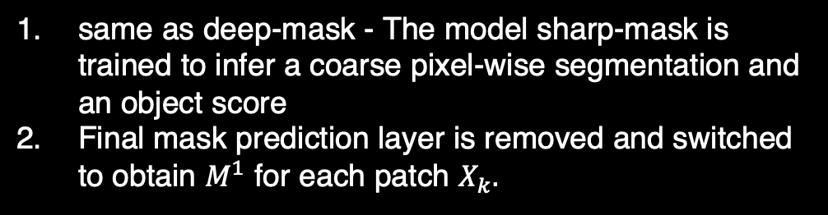
Training – stage training
same as deep-mask - The model sharp-mask is trained to infer a coarse pixel-wise segmentation and an object score
Final mask prediction layer is removed and switched to obtain $M^{1}$ for each patch $X_{k}.$
Stage I
The feed-forward path is frozen
Refinement modules are trained
Stage II

Slide 23
inference
Same as deep-mask:
Each image is divided into k patches
At least one patch which includes an object
Choose the winning mask via non-max-suppression.

Slide 24
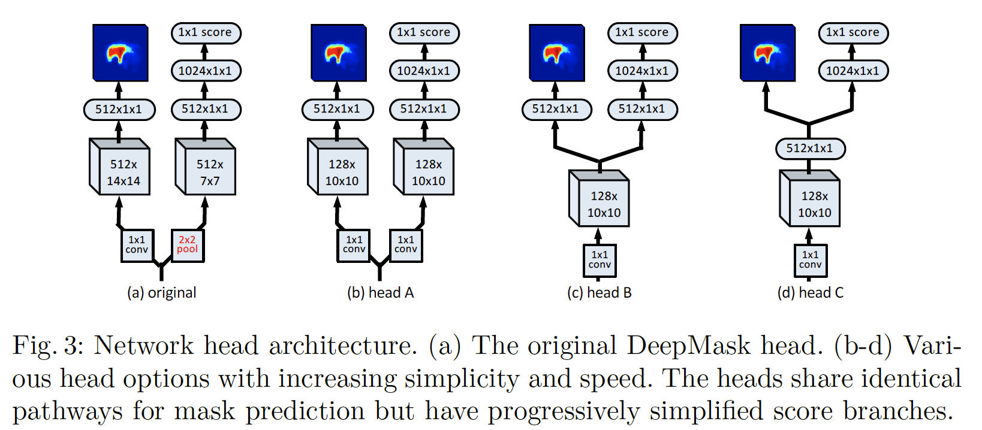
HEAD ARCHITECTURE modifications

Slide 25
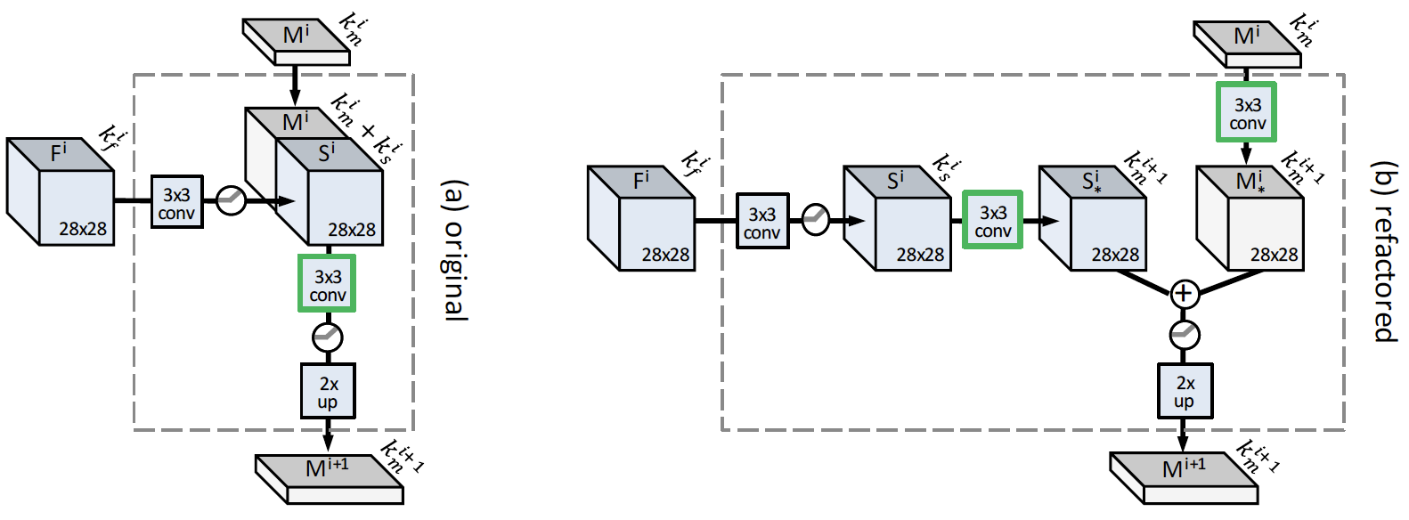
Refinement module modifications

Slide 26
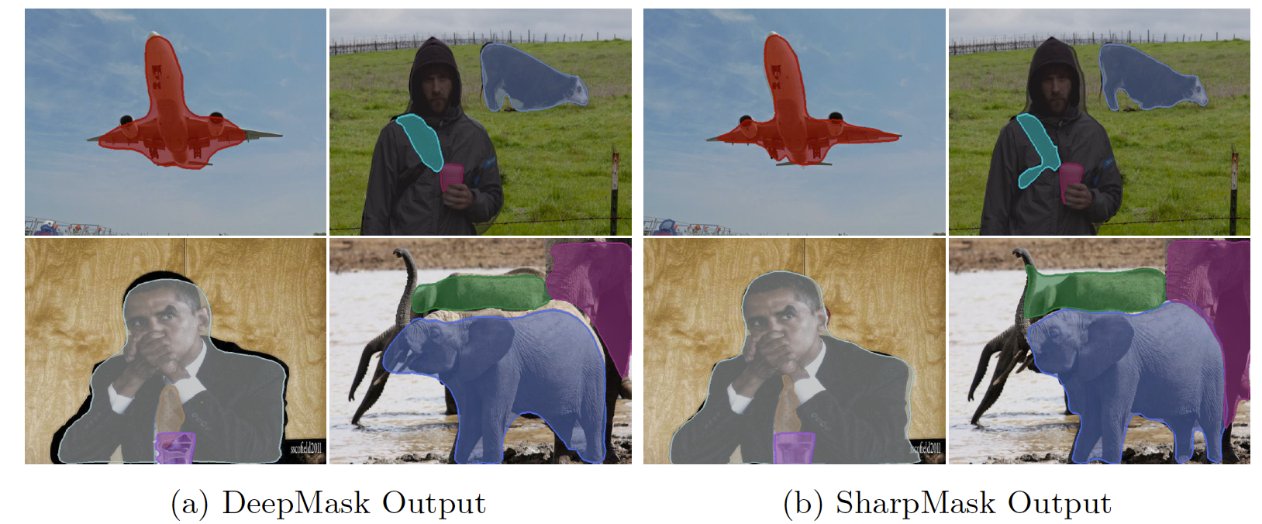
Visual results

Slide 27

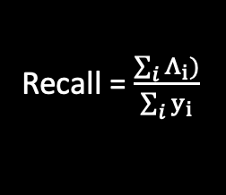
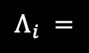
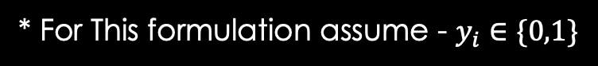
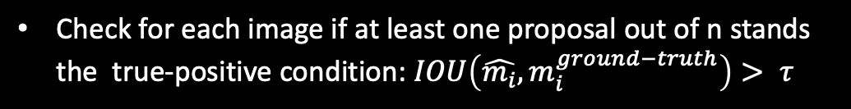
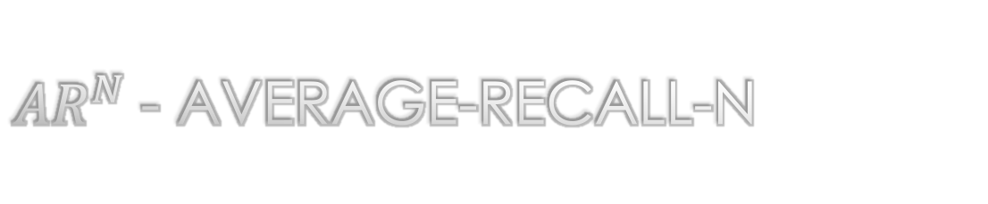
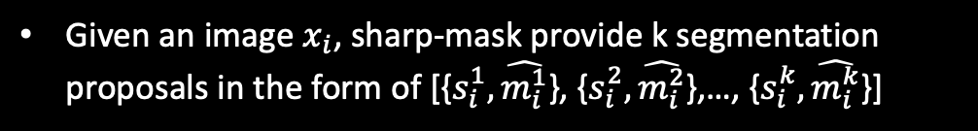
$AR^{N}$- Average-recall-n
Given an image $x_{i}$, sharp-mask provide k segmentation proposals in the form of [{$s_{i}^{1},\hat{m_{i}^{1}}$}, {$s_{i}^{2},\hat{m_{i}^{2}}$},…, {$s_{i}^{k},\hat{m_{i}^{k}}$}]
while $s_{i}^{j}$ is the proposal score and $\hat{m_{i}^{j}}$is a binary mask.
Sort proposals via their scores and pick the highest n proposals. (n<k)
Check for each image if at least one proposal out of n stands the true-positive condition: $IOU\left(\hat{m_{i}},m_{i}^{ground−truth}\right)> τ$
Calculate recall upon the dataset.
Recall = $\frac{\sum_{i}{Λ_{i}})}{\sum_{i}{y_{i}}}$
1, if one out of N proposals verify $IOU\left(\hat{m_{i}^{j}},m_{i}^{ground−truth}\right)> τ$
$$Λ_{i} =$$
0, else
* For This formulation assume - $y_{i}∈\{0,1\}$

Slide 28
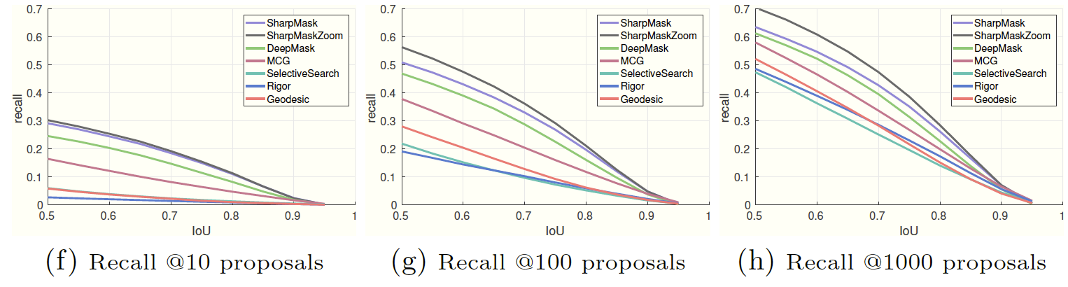

IOU THRESHOLD $(τ$) VS RECALL VALUE

Slide 29
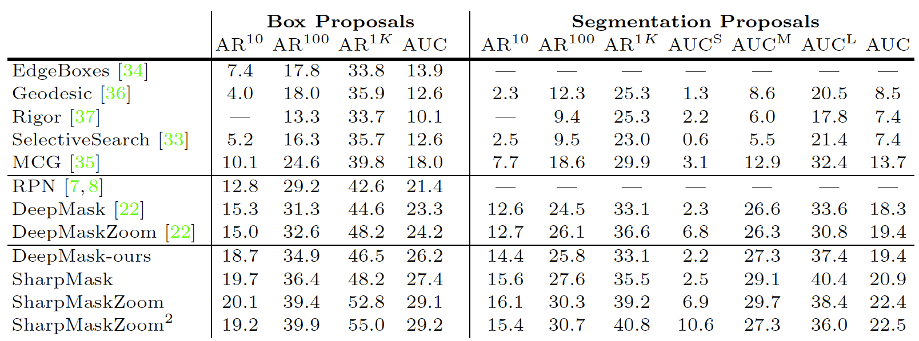
Area Under Curve (Recall Graph)
Variant of Sharp-Mask which scales the image and aggregate predictions to boost AR

Slide 30

Thank you for listening Questions?

